Slide 1


Development of a highly sensitive multiplex PCR assay for Plasmodium vivax
Chloe M. Hasund
9/6/2024 Neafsey Lab Meeting

Slide 2
Presentation outline
Background
PvGT8seq workflow
Results
Conclusions and Next Steps
COI
P. vivax
Marker selection
Library prep
Sequencing
R analysis
Assay performance
Multiplex comparison
Top contender
Applications
Notes:
Analysis in R
Malaria Amplicon Pipeline
MHap-Analysis

Slide 3
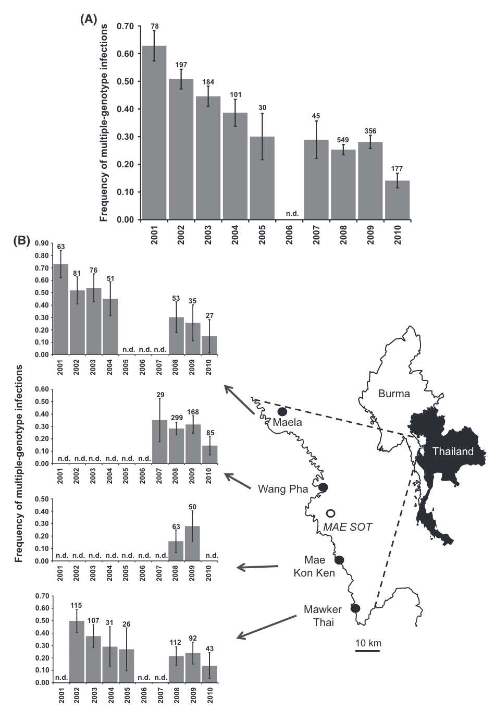


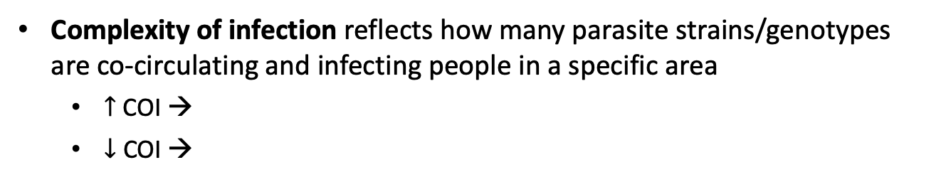
Complexity of infection (COI) is an important correlate of malaria transmission level
Complexity of infection reflects how many parasite strains/genotypes are co-circulating and infecting people in a specific area
$↑$COI →
$↓$ COI →
Reduction in frequency of infections containing multiple parasite genotypes from 63% to 14%
No changes in level of genetic drift → expected heterozygosity, geographical structure, short-term N_{e}
Notes:
people are more frequently exposed to mosquito bites and thus a wider variety of parasite strains
10 years, Thai-Burma border; transmission intensity measured via incidence (through pregnant women attending weekly antenatal clinics, P. falciparum consultations among children <5 presenting to four clinics)
Illumina GoldenGate to genotype infections at 96 SNPs
Effective population estimations derived from allele frequencies fluctuation --> remained high
Caveat with COI: dependent on sensitivity of the genotyping methods used

Slide 4
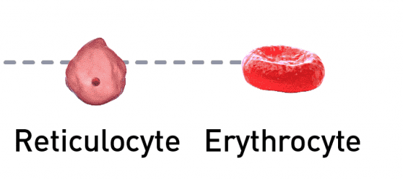
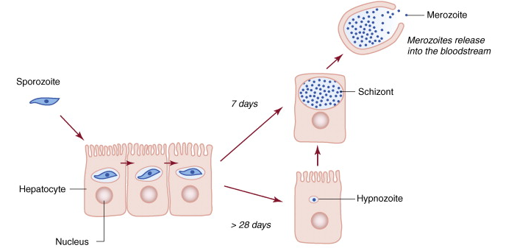

P. vivax generally produces lower levels of parasitemia compared to P. falciparum
$$>$$
P. vivax preferentially invades reticulocytes (immature RBC)
The presence of dormant hypnozoites means not all liver-stage parasites are released into the bloodstream at once
Wells et al., Trends in Parasit (2010)
Notes:
Reticulcytes less abundant in the bloodstream

Slide 5
Rotation Aim
Create a sensitive multiplex assay capable of estimating COI in low parasitemia samples

Slide 6
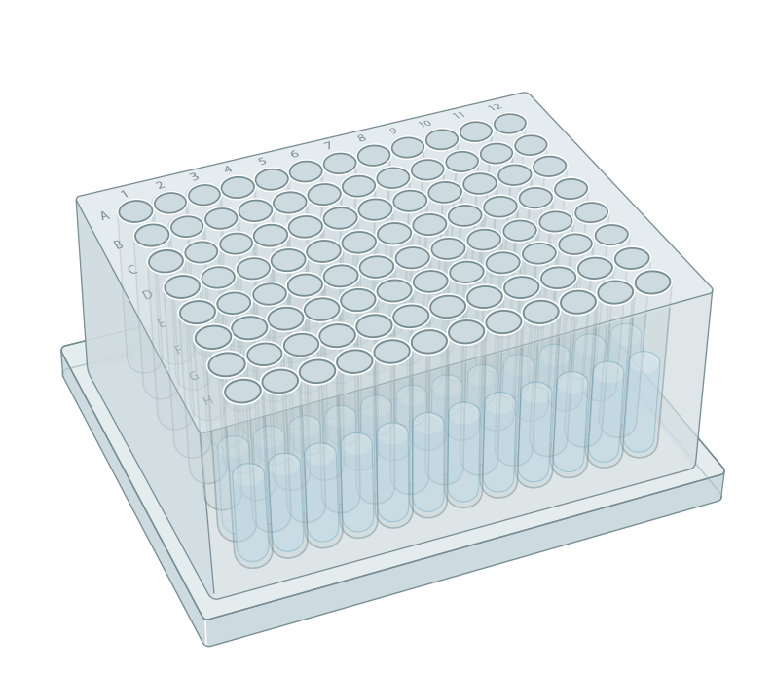
We selected monoclonal samples that were readily available and had both a high amplification rate and parasite concentration
Sample_ID | Amp rate | P. vivax concentration (parasite genomes/µL of DNA)
G4G2463 | 0.94270833 | 1204.58777
HRP0378 | 0.91145833 | 290.965707

Slide 7
Markers were selected from PvGTseq (249 amplicons) based on three specific criteria
Selection criteria:
Chromosome location
Amplification rate
Estimated heterozygosity
Estimated heterozygosity
Loci | PvP01 chromosome | Total amp rate in PvGTseq | Colombia | Guyana | Honduras | Venezuela | All
DBP_1 | 6 | 0.6 | 0.47 | 0.69 | 0 | 0.72 | 0.67
RBP2b_3 | 8 | 0.56 | 0.36 | 0.74 | 0.4 | 0.45 | 0.71
RIPR | 8 | 0.6 | 0.62 | 0.72 | 0.51 | 0.77 | 0.77
SLARP | 9 | 0.63 | 0.51 | 0.67 | 0.5 | 0.63 | 0.70
PIGM | 13 | 0.71 | 0.73 | 0.72 | 0.63 | 0.74 | 0.74
VSP11 | 10 | 0.75 | 0.6 | 0.53 | 0.47 | 0.43 | 0.57
FRM1_1 | 10 | 0.63 | 0.73 | 0.81 | 0.56 | 0.86 | 0.84
CG2_related | 14 | 0.76 | 0.62 | 0.63 | 0.43 | 0.61 | 0.66

Slide 8
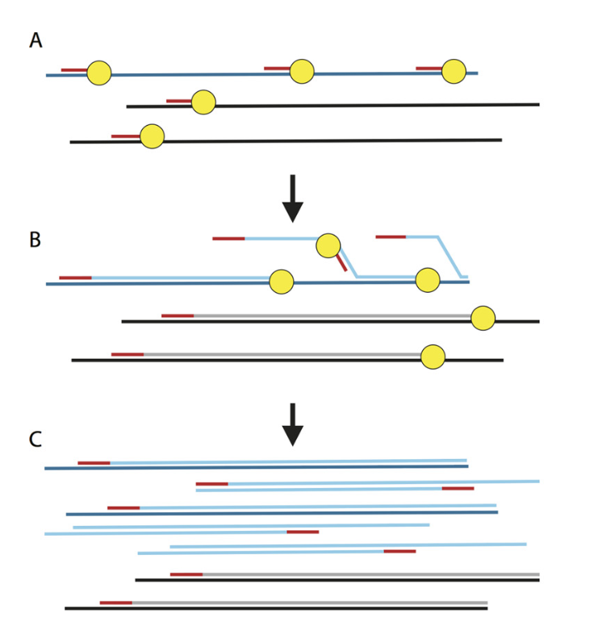
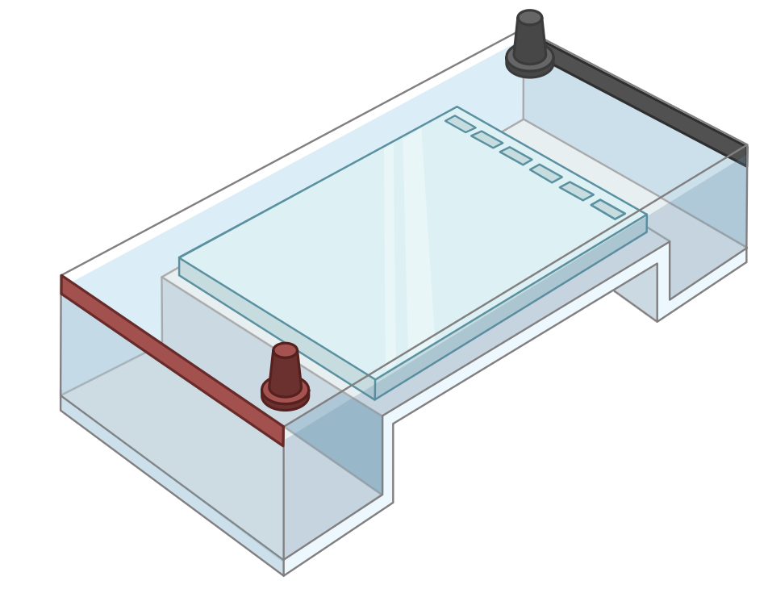
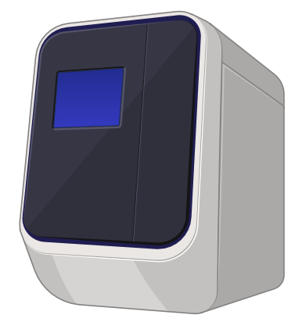
Summary of GT8seq workflow
1. sWGA
2. Gel electrophoresis and qPCR

Slide 9
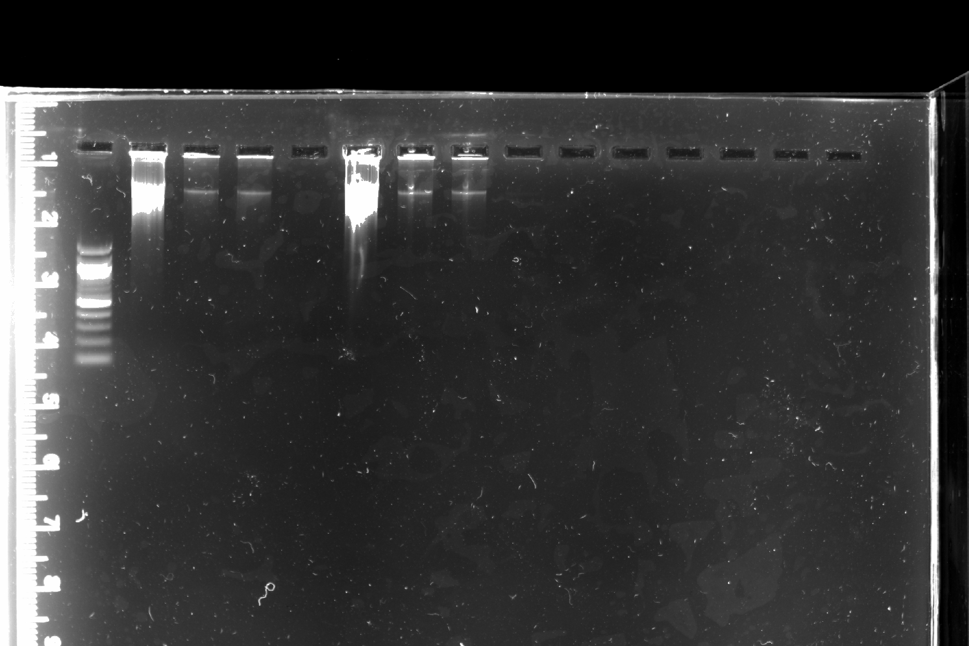
Gel electrophoresis confirmed that sWGA was successful
1:10
1:1000
1:10
Neat
1:100
Ladder
1:1000
Neat
1:100
G4G2463
HRP0378
Notes:
Size labels for ladder?

Slide 10
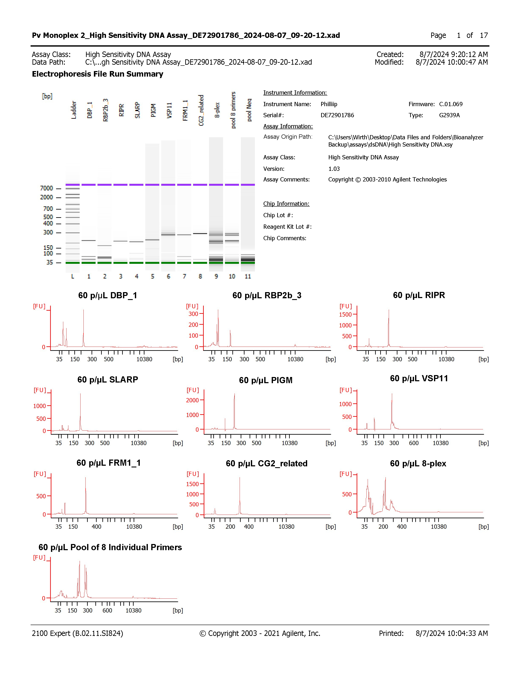

Summary of GT8seq workflow
1. sWGA
2. Gel electrophoresis and qPCR
3. BioAnalyzer

Slide 11
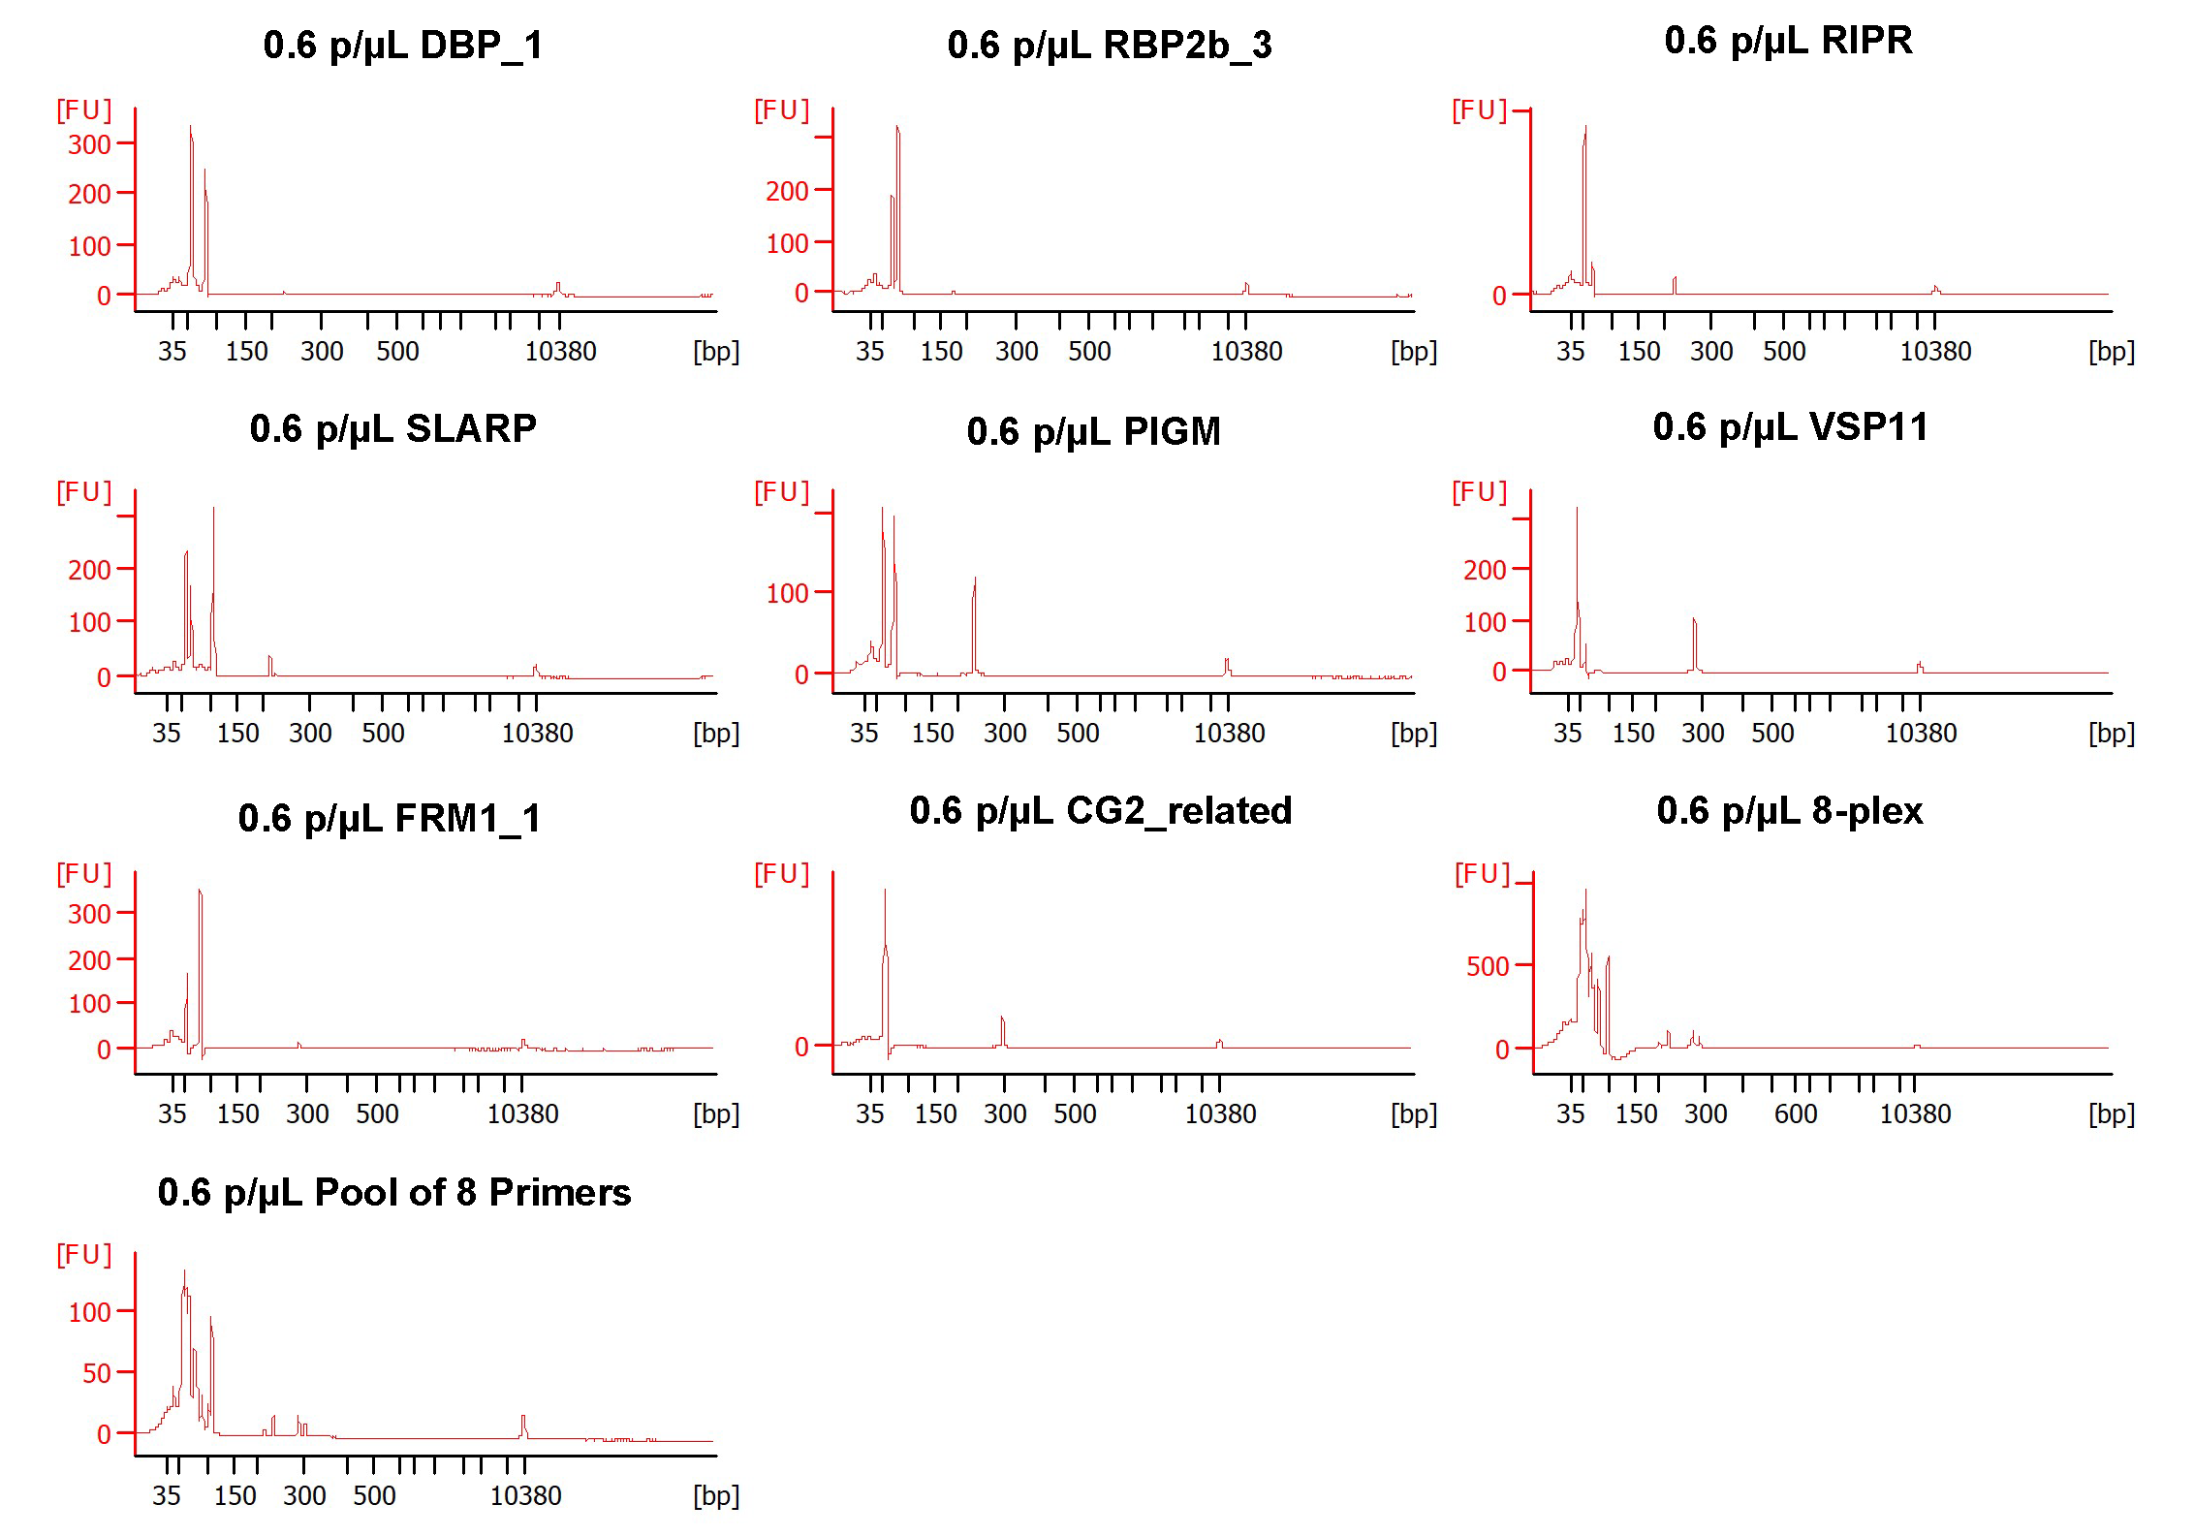
Multiplexes were designed based on the individual performance of primers at different dilutions
1:100 or 60p/uL
1:10000 or 0.6p/uL
60 p/µL Pool of 8 Primers

Slide 12
6 multiplexes were selected for the MiSeq run
Chromosome
8plex |  | 6plex1 |  | 6plex2 |  | 6plex3 |  | 4plex1 |  | 4plex2
DBP_1 |  |  |  | DBP_1 |  | DBP_1 |  |  |  | DBP_1
RBP2b_3 |  | RBP2b_3 |  |  |  | RBP2b_3 |  |  |  | RBP2b_3
RIPR |  | RIPR |  | RIPR |  |  |  | RIPR |  | RIPR
SLARP |  | SLARP |  | SLARP |  | SLARP
PIGM |  | PIGM |  | PIGM |  | PIGM |  | PIGM |  | PIGM
VSP11 |  | VSP11 |  | VSP11 |  |  |  | VSP11
FRM1_1 |  |  |  |  |  | FRM1_1
CG2_related |  | CG2_related |  | CG2_related |  | CG2_related |  | CG2_related
6
8
8
9
13
10
10
14
Rationale
Got rid of 2 worst | Chromosome duplicates, performed worse | Opposite of 6plex2 | Best performers | Top 2 performers and markers of interest
Notes:
5 dilutions – 1:100, 1:1000, 1:5000, 1:10000, 1:50000
2 biological replicates

Slide 13
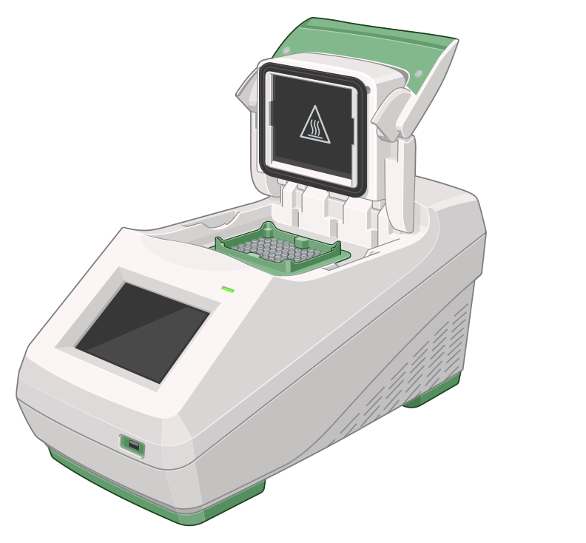


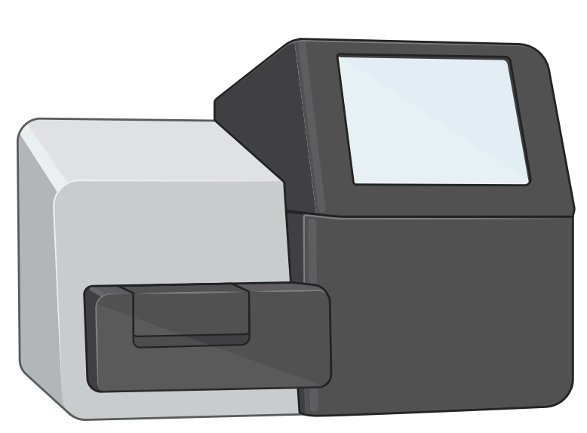
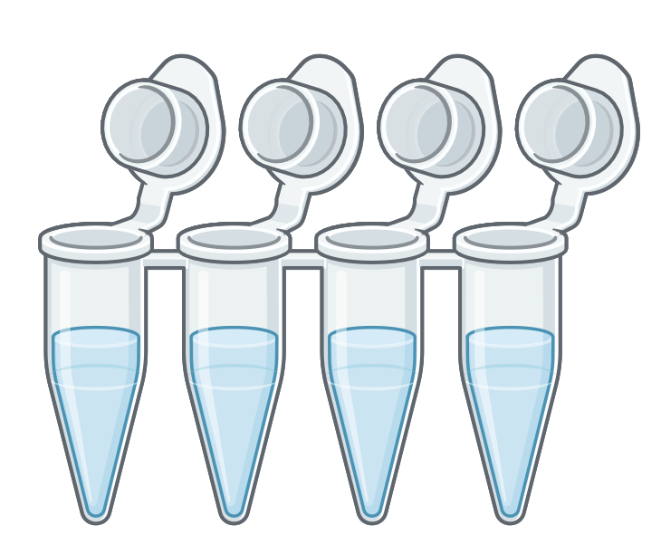
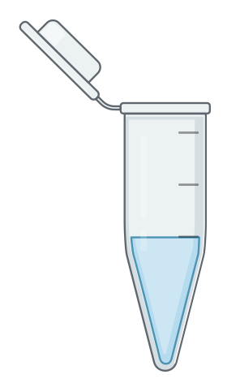

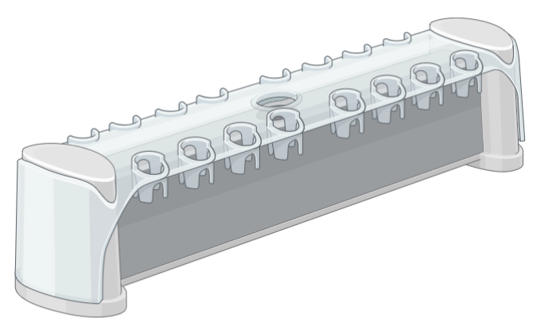
Summary of GT8seq workflow
1. sWGA
2. Gel electrophoresis and qPCR
3. BioAnalyzer
4. Multiplex PCR1
DBP_1
RBP2b_3
RIPR
SLARP
PIGM
VSP11
FRM1_1
CG2_related
9. Malaria Amplicon Pipeline & MHap-Analysis
5. Multiplex PCR2: Indexing
Nextera UDI primers
8. MiSeq
7. QuBit
6. Bead clean-up

Slide 14
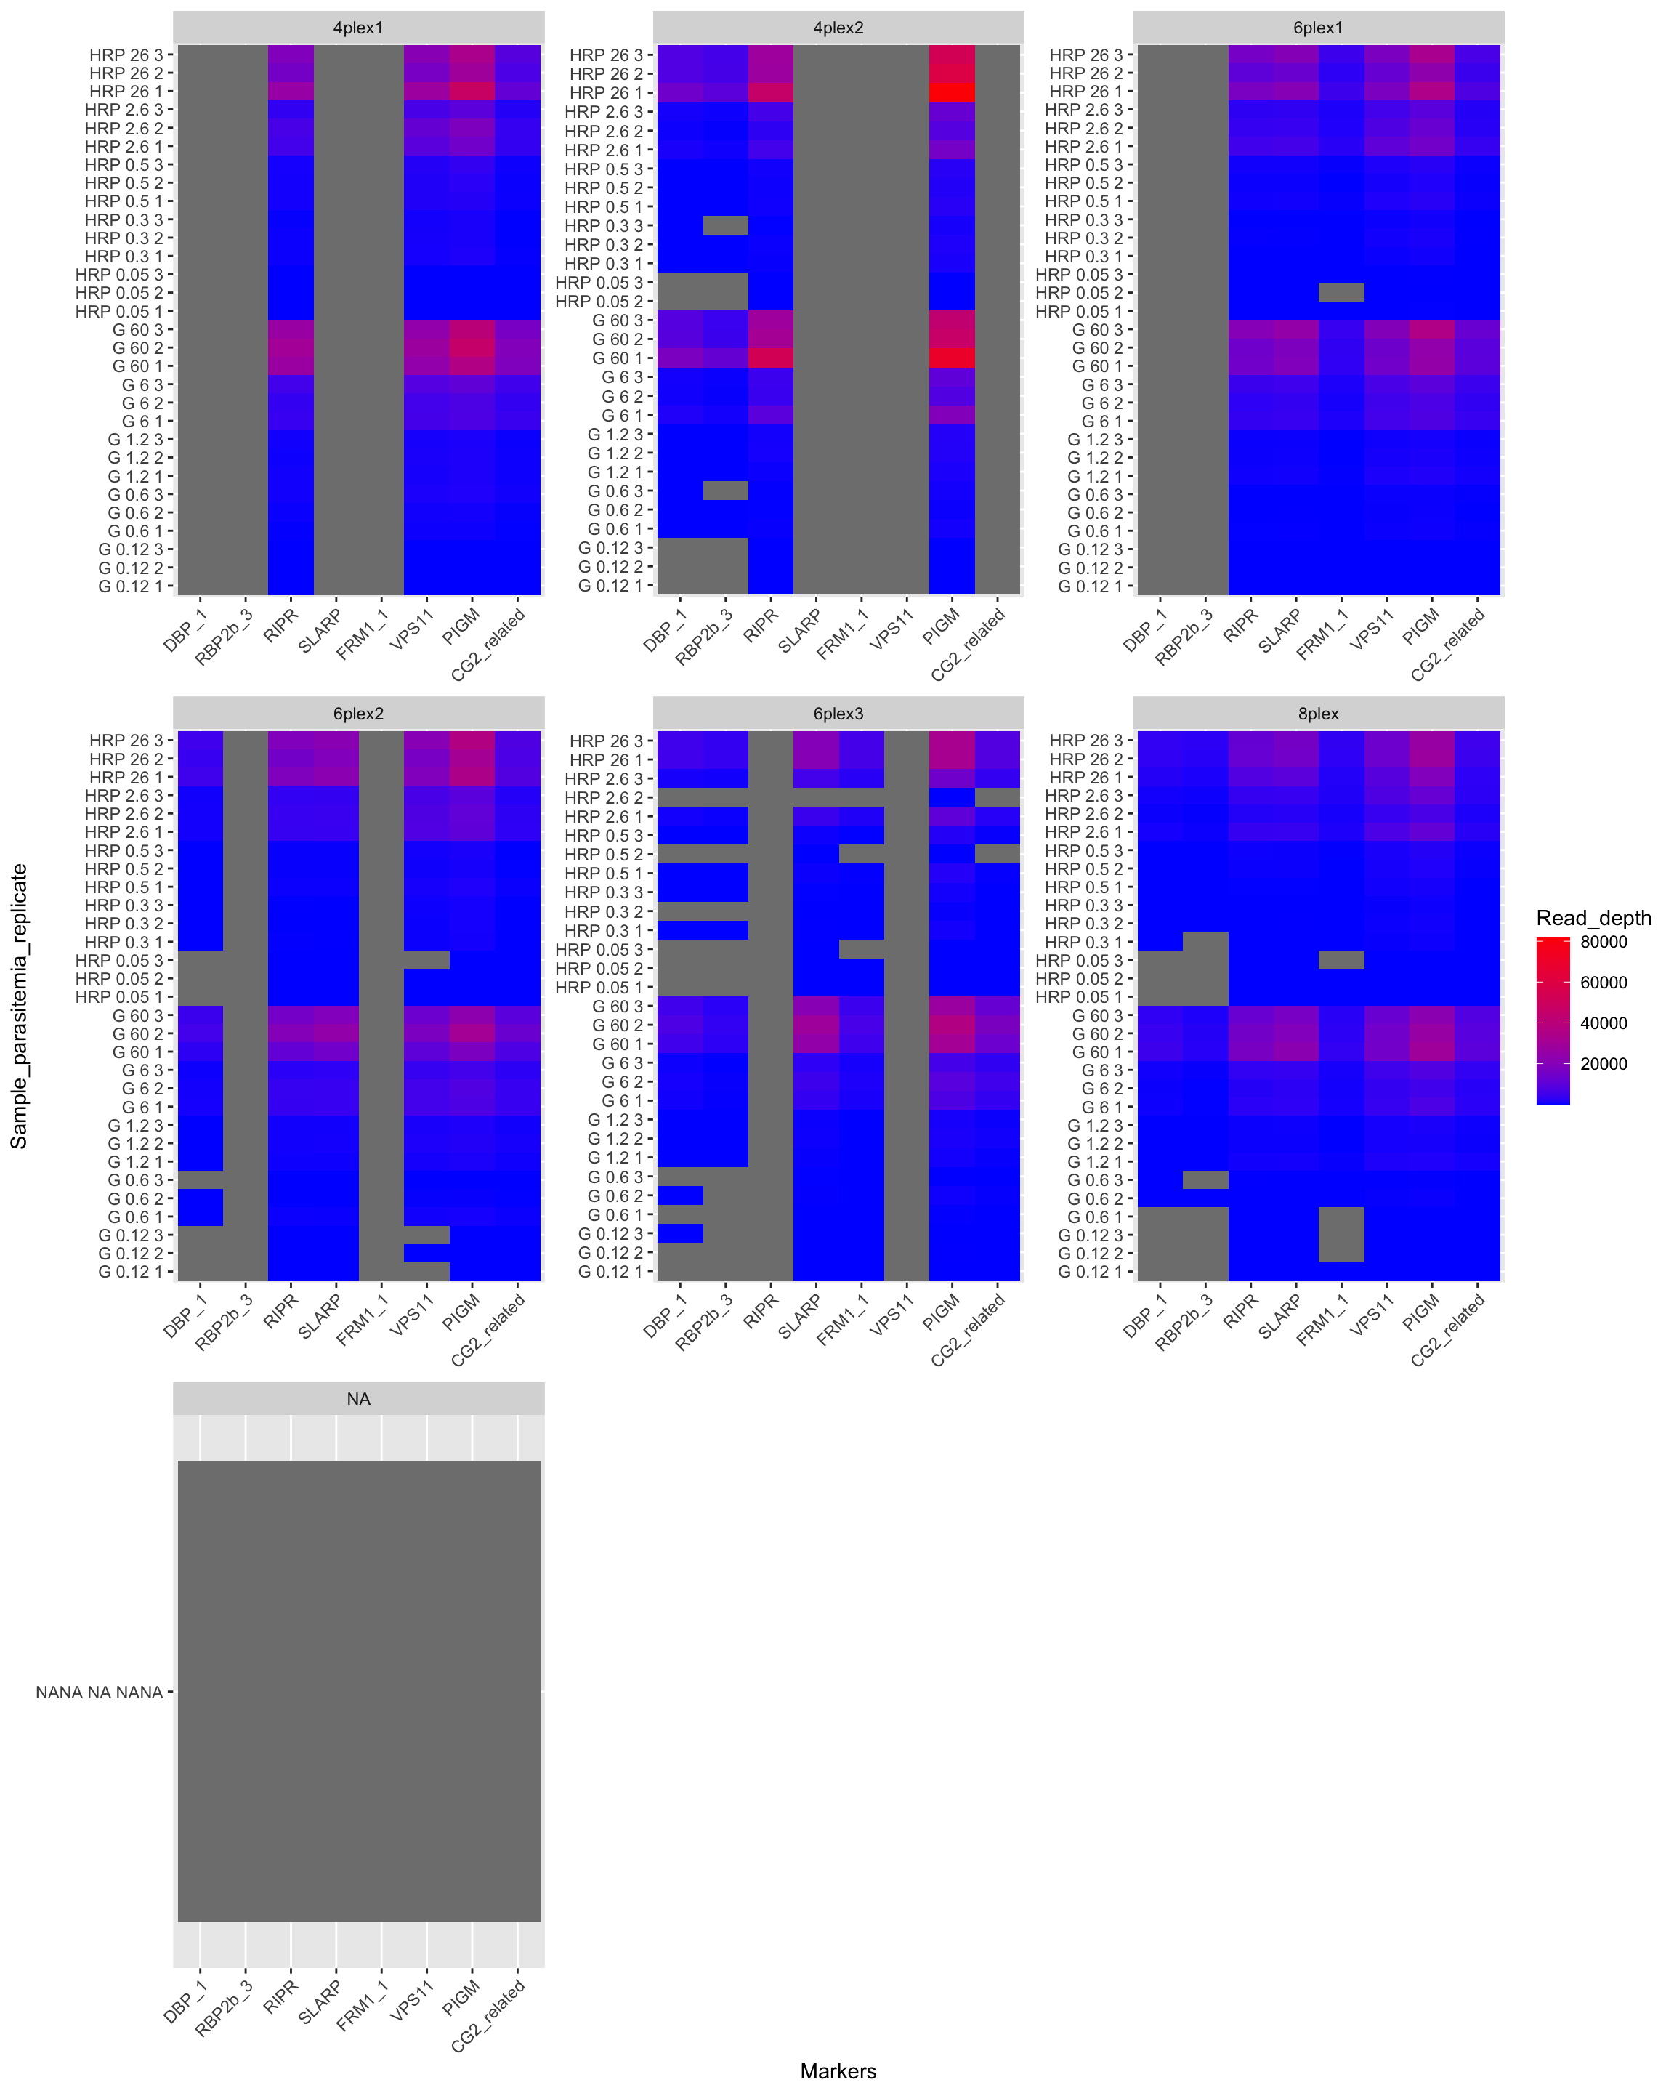
Coverage of the different multiplexes was robust and generally consistent
Increasing dilution
Parasitemia (p/µL)
HRP 26 3
Sample
Biological Replicate
Technical Replicate

Slide 15
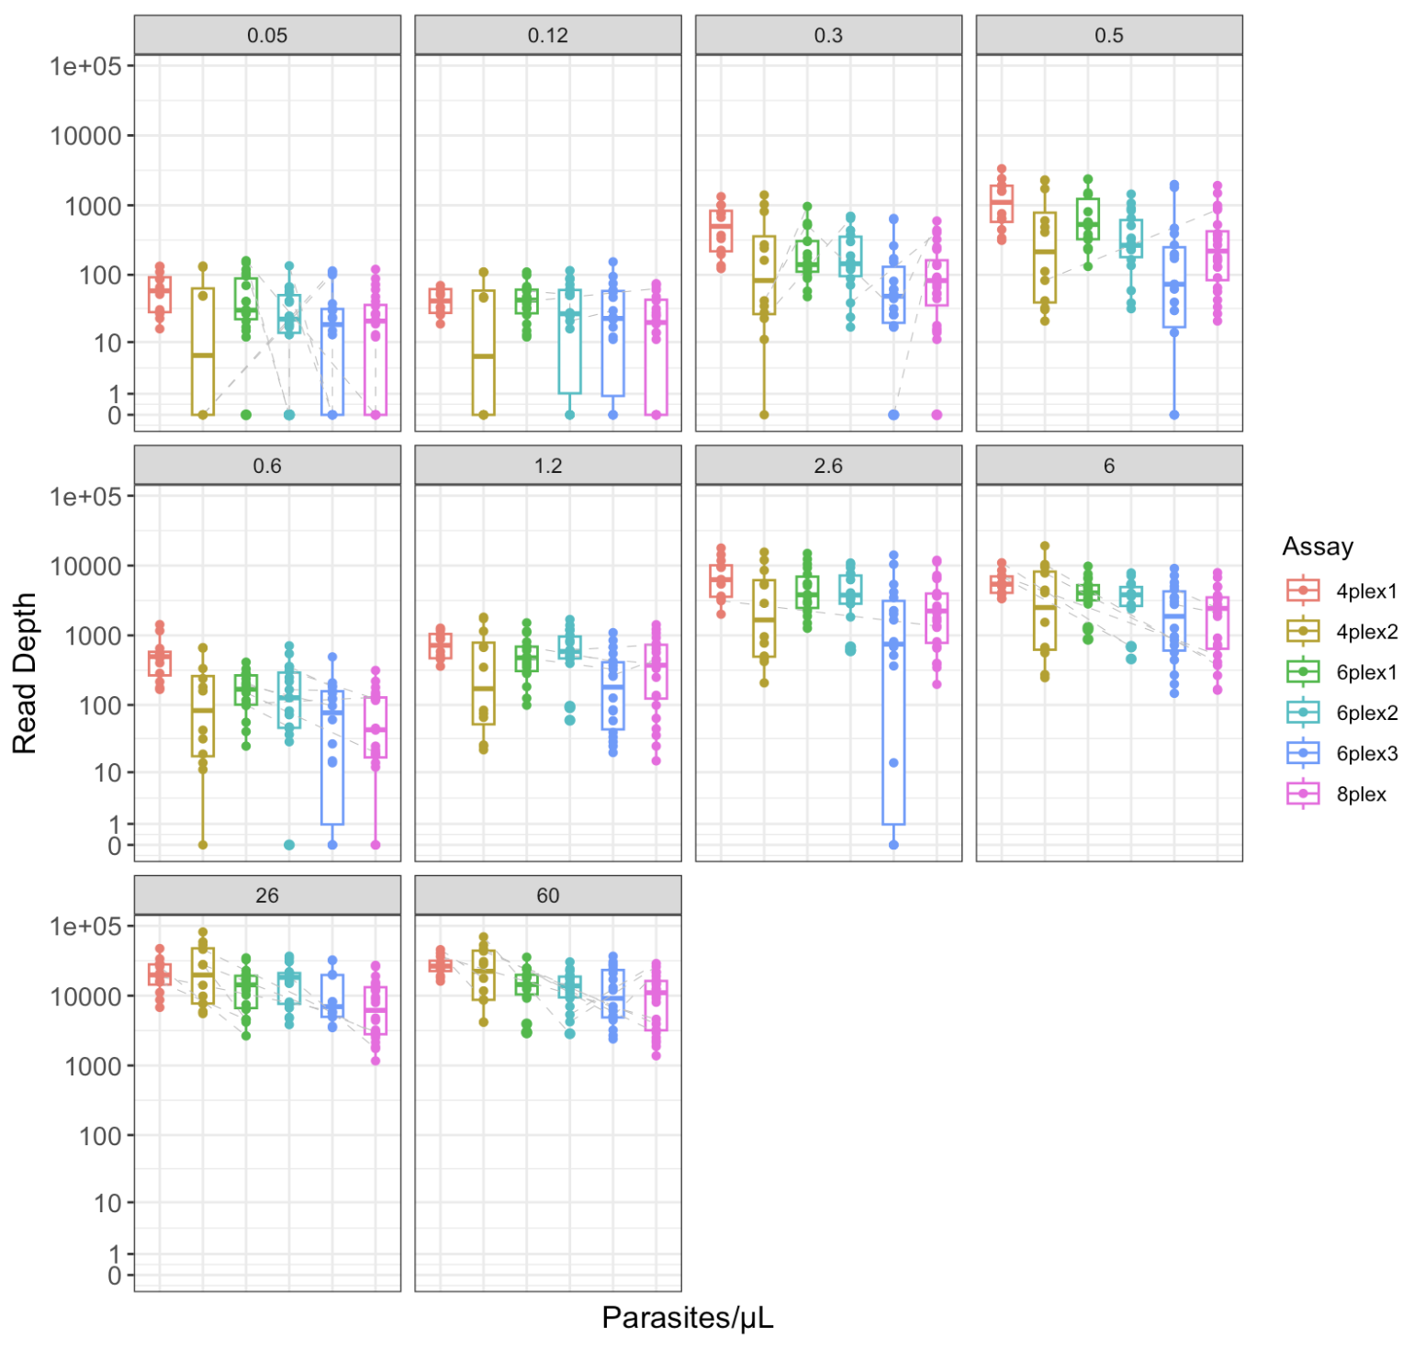
Stratifying multiplex data by parasitemia identifies leading candidates

Slide 16
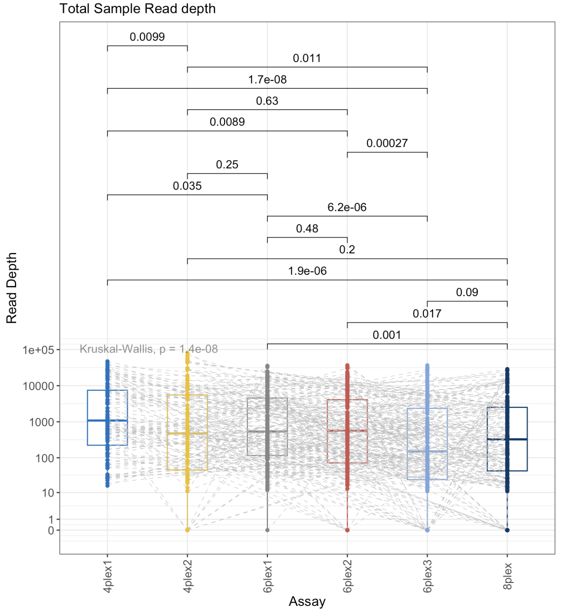
4plex1 is the best performer
PIGM – biosynthesis of GPI anchors; involved in host cell invasion, immune evasion and parasite survival
RIPR – reticulocyte invasion (RH5-RIPR-CyRPA complex)
VSP11 – surface antigen variation/immune invasion
CG2_related – associated with drug resistance

Slide 17
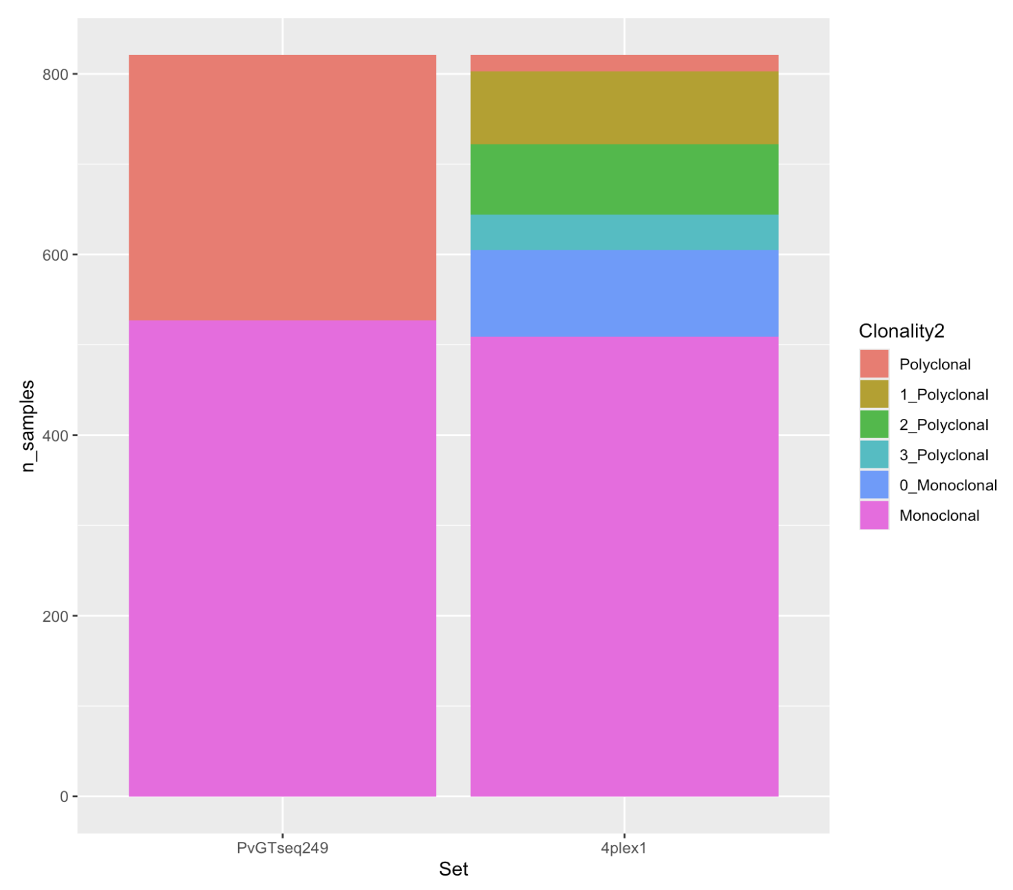
4plex1 correctly identified 73.5% of the Guyana samples PvGTseq classified as polyclonal

Slide 18
Conclusions and next steps
Conclusions
A highly sensitive tool is useful for COI estimation of low parasitemia samples
Ex. MalaKit samples
4plex1, consisting of PIGM, RIPR, VSP11, CG2_related, was the strongest multiplex contender
Next steps
Simulations to determine how likely 4plex1 could identify a COI of 2, 3, and potentially 4 in a variety of settings
Debut 4plex1 in Paulo’s PvGTseq paper similarly to what was done for 4CAST

Slide 19

Acknowledgements
T32 IID training grant
BPH program
Notes:
Special thanks to Paulo and Katrina without whom the execution of this project would not have been possible, and to Dan for giving me the opportunity to rotate in the lab ☺

Slide 20
Acronym voting!
CRiSP

Slide 21
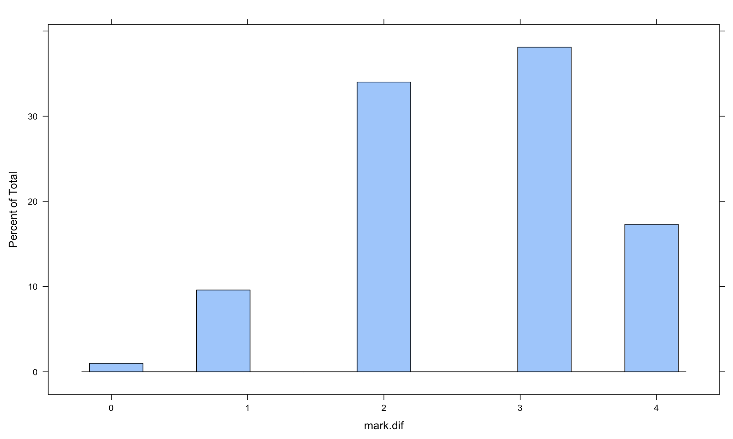
Ideas for predicting COI??
all4 <- filter_samples(filtered.dat, amplified.loci == 4)
mark.dif = NULL
for (i in 1:1000){
test1 <- sample(all4@metadata$Sample_id, 2, replace = FALSE)
genotype1 <- gsub(":\\d+$", "", all4@gt[test1[1], ])
genotype2 <- gsub(":\\d+$", "", all4@gt[test1[2], ])
mark.dif <- c(mark.dif, sum(genotype1 != genotype2))
}
histogram(mark.dif)

Slide 22
Malaria is a significant global public health threat
Caused by Plasmodium parasite
5 species cause disease in humans: P. falciparum, P. vivax, P. ovale, P. malariae, P. knowlesi
Transmitted by the female Anopheles mosquito
3.3 billion people or half of the world’s population are at risk
In 2022, ~249 mil cases and 608,000 deaths
Multiplicity/complexity of infection (MOI/COI) is an important indicator of malaria transmission level
https://www.who.int/news-room/fact-sheets/detail/malaria

Slide 23
Summary of GT8seq workflow
1. sWGA
2. Gel electrophoresis and qPCR
3. BioAnalyzer
4. Multiplex PCR1
DBP_1
RBP2b_3
RIPR
SLARP
PIGM
VSP11
FRM1_1
CG2_related
9. Malaria Amplicon Pipeline & MHap-Analysis
5. Multiplex PCR2: Indexing
Nextera UDI primers
8. MiSeq
7. QuBit
6. Bead clean-up

Slide 24
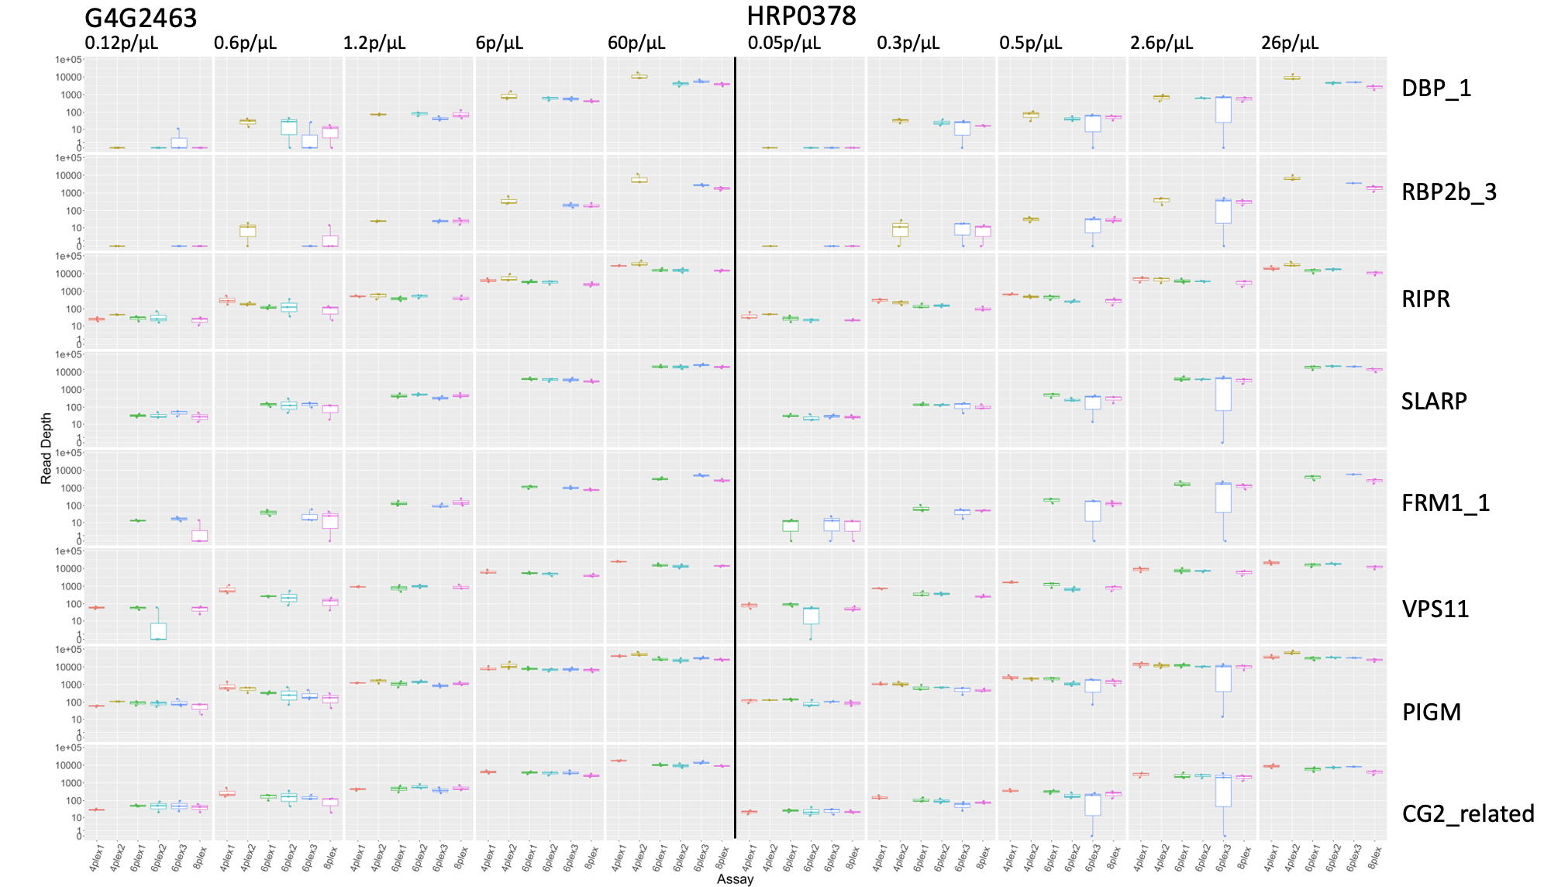
Marker performance varied but was consistent across multiplexes and overall decreased with parasitemia

Slide 25
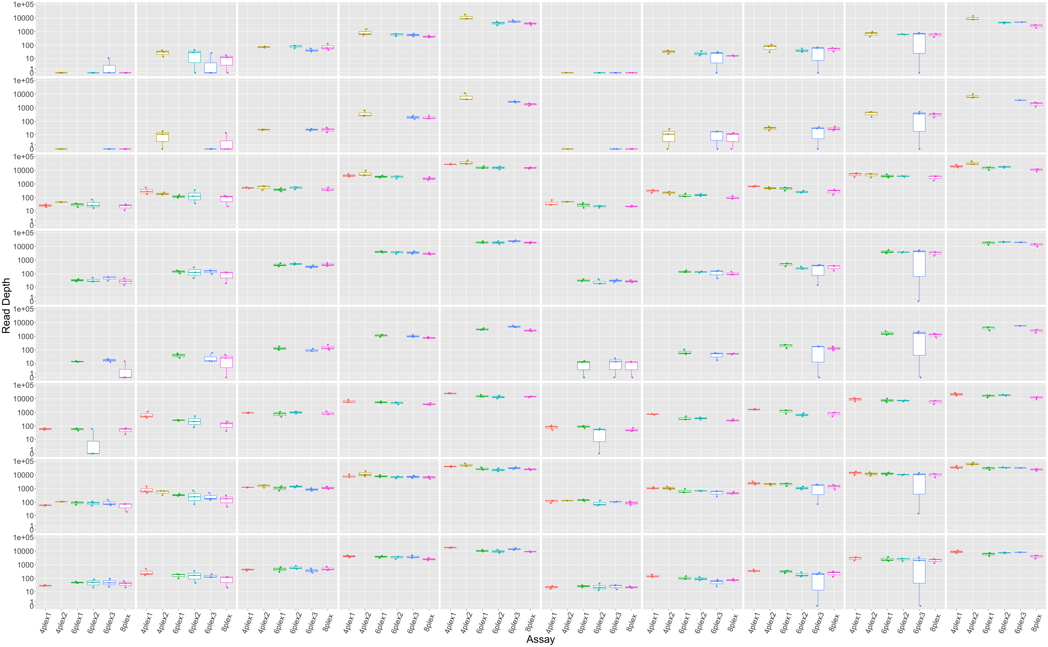
G4G2463
HRP0378
0.12p/μL
0.6p/μL
1.2p/μL
6p/μL
60p/μL
0.05p/μL
0.3p/μL
0.5p/μL
2.6p/μL
26p/μL
DBP_1
RBP2b_3
RIPR
SLARP
FRM1_1
VPS11
PIGM
CG2_related

